Slide 1
OSGI
Key Concepts
Presenter:
Martin Ferlan
Organization:
ATRON electronic GmbH

Slide 2
Introduction
Dynamic modular system
Service platform for Java
Implements complete and dynamic component model

Slide 3
Powers popular IDE (Eclipse)
Application servers (GlassFish, IBM Websphere, Oracle/BEA Weblogic, Jonas, JBoss),
Web applications (eBay, Salesforce.com, Liferay)
IoT - designed for embedded devices
  Bosch
  Hitachi
  Deutsche Telekom
  Schneider Electric...

Slide 4
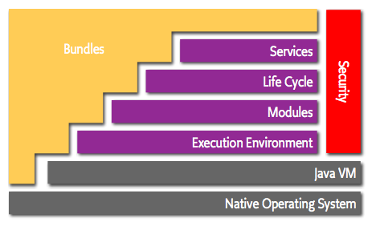
OSGI Core Platform
Notes:
Bundles
– Bundles are the OSGi components made by the developers.
Services
– The services layer connects bundles in a dynamic way by offering a publish-find-bind model for plain old Java objects.
Life-Cycle
– The API to install, start, stop, update, and uninstall bundles.
Modules
– The layer that defines how a bundle can import and export code.
Security – The layer that handles the security aspects.
Execution Environment
– Defines what methods and classes are available in a specific platform

Slide 5
Enterprise specification
complements Core Platform specification
addresses enterprise use cases
  Configuration and management
  Component model and IoC
  Service distribution
  Jave EE integration

Slide 6
Modularity
Open topic for a long time

Slide 7
Modules
Self contained
Highely cohesive
Loosely coupled

Slide 8
Benefits
Separation of concerns
Code reuse
Design simplicity
Parallel development
Ease of maintenance and repair

Slide 9
Is Java modular
Classes
Packages
JAR's
Build system ( Maven, Ant, Ivy, Gradle )

Slide 10
Is Java modular
Classes
  Encapulated
    Except there are internal dependencies
      Implementation dependencies
      In a signature e.g. argument types
  CANNOT be module

Slide 11
Is Java modular
Classes
Packages
  Boundaries for classes
  Except:
    Cyclic references between packages
    Don't matter for JVM. Used only to define unique signature for classes

Slide 12
Is Java modular
Classes
Packages
JAR's
  Elements of deployment
  NOT modules
  Do not exist in runtime
  No explicit declaration of dependencies (except file based claspath declaration)
  No versioning

Slide 13
Build systems
Versioning
  Static
  Contract respected by the tools only
  In JVM, depending on linear CLASSPATH

Slide 14
Build systems
Easy to manage dependencies ???
  Multiple versions of the same dependency not supported
    “first one wins”
    Inconsistent behavior
    Different behavior development and production

Slide 15
Java Modularity Solutions
JSR 8: Open Service Gateway Initiative
  March 1999

Slide 16
Java Modularity Solutions
JSR 8: Open Service Gateway Initiative
JSR 277: Java Module System
  Published in 2005
  Put on hold 2008

Slide 17
Java Modularity Solutions
JSR 8: Open Service Gateway Initiative
JSR 277: Java Module System
JSR 291: Dynamic Component Support for Java SE

Slide 18
Java Modularity Solutions
JSR 8: Open Service Gateway Initiative
JSR 277: Java Module System
JSR 291: Dynamic Component Support for Java SE
JSR 294: Improved Modularity Support in Java

Slide 19
Java Modularity Solutions
JSR 8: Open Service Gateway Initiative
JSR 277: Java Module System
JSR 291: Dynamic Component Support for Java SE
JSR 294: Improved Modularity Support in Java
JSR 376: Java Platform Module System
  Jigsaw project
  Revived in 2014
  Release in March 2017

Slide 20
Modularity in Java
… 18 years ...

Slide 21
Modularity
… is hard...

Slide 22
OSGI and modularity
Embodied in the bundle concept
Isolation
  Packages are interface for modules
  Bundle can export (provide) a package
  Bundle can import (require) a package
  Achieved thru classloader

Slide 23
Classloading
Classloader per bundle
Highely optimised
  Classloaders created at the last moment
  Smaller set of types loaded per classloader
NoClassDefFoundError
Supported multiple versions of same package and libraries in runtime

Slide 24
OSGI metadata
Bundle – plain jar with additional meta information
META-INF/MANIFEST.MF
Bundle metadata
  Symbolic name
  Version
  List of imported and exported packages
  ...

Slide 25
Manifest file can be used for:
construction of paths by the compiler
for ensuring dependencies in runtime
wiring projects in IDEs
resolving dependencies from repositories
showing content on GUI
documentation – readable by humans

Slide 26
Manifest-Version: 1.0
Bundle-ManifestVersion: 2
Bundle-SymbolicName: com.example.myosgi
Bundle-Name: My OSGI bundle
Bundle-Version: 1.0.0
Import-Package: com.example.util
Require-Bundle: org.eclipse.osgi
Export-Package: com.example.myosgi
Bundle-Activator: com.example.myosgi.Activator
Bundle-ActivationPolicy: lazy
Bundle-RequiredExecutionEnvironment: JavaSE-1.6

Slide 27
OSGI specification
Require-Bundle
  Dependency on complete bundle
  Simple to use
  Imports packages that are never used
Import-Package
  Creates less brittle bundles due to substitutability
  More cumbersome to use ( tools help a lot )
  Recommeded in most cases

Slide 28
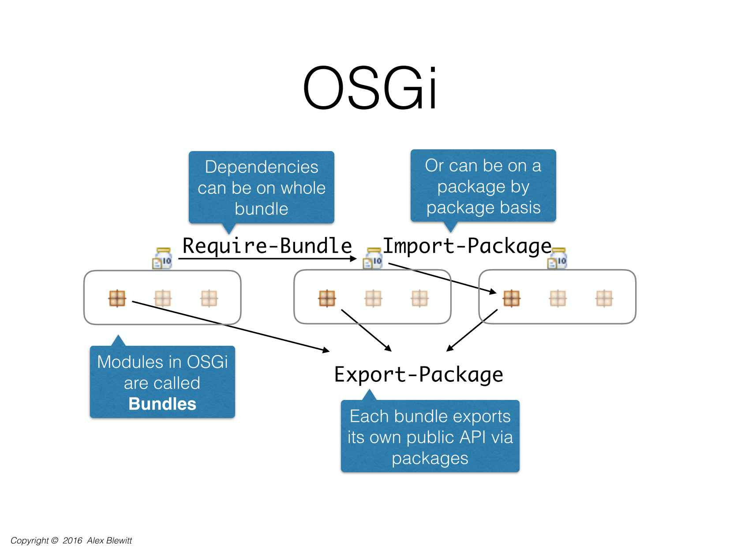

Slide 29
Versioning
Bundles are versioned
<major>.<minor>.<patch> schema recommeded
Package can be versioned as well
Export-Package: com.example.myosgi;version=”1.0.0”

Slide 30
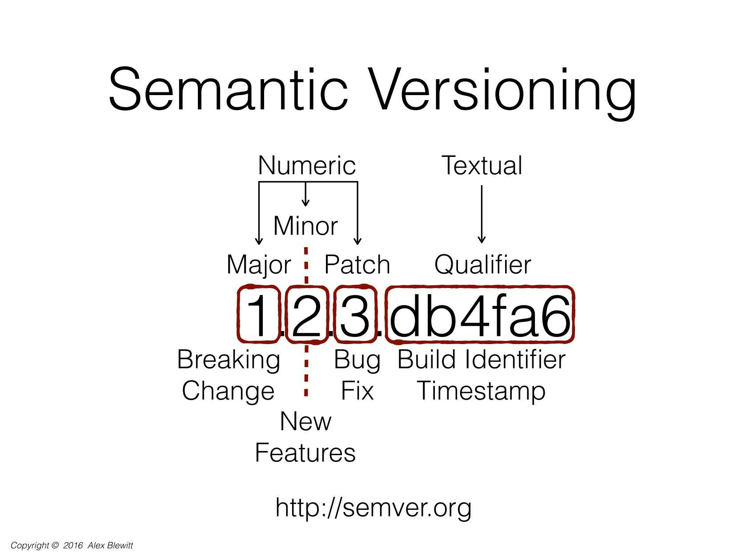

Slide 31
OSGI Service Platform
Collaboration model
  Service objects
  Package sharing

Slide 32
Usage
  Define a service interface
  Write implementation class
  Register service implementation with the Framework
  Consume existing services

Slide 33
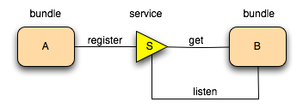
OSGI Services

Slide 34
Framework manages collaboration
  Dependencies
  Security
  Service discovery
    Active search with query filter
    Listener interface
  Service ranking
  properties
Services can go away at any time !!

Slide 35
OSGI services
Cornerstone of OSGI
Naming
  “services” ( similiarity with SOA)
  Micro-services (similarity with REST micro services)
  μservice (latest name :) )

Slide 36
Service Oriented Architecture
OSGI Service Platform is SOA without communication overhead
Separate contract from implementation
Allow alternative implementations
Dynamic discover and bind available implementations
Binding based on contract (interface)
Reusable components
Components are coupled to public interface
(not to implementation details)

Slide 37
OSGI's Focus
Modularity
Class loading control
Small services
  Focused purpose (or just single purpose)

Slide 38
Sounds like...

Slide 39
Micro-Services

Slide 40
Difference
Micro-services
  Own container
OSGI container
  Host to multiple services

Slide 41
Lifecycle
API for managing module at runtime
Adds dynamics
  normally not part of application
Fully protected with security architecture

Slide 42
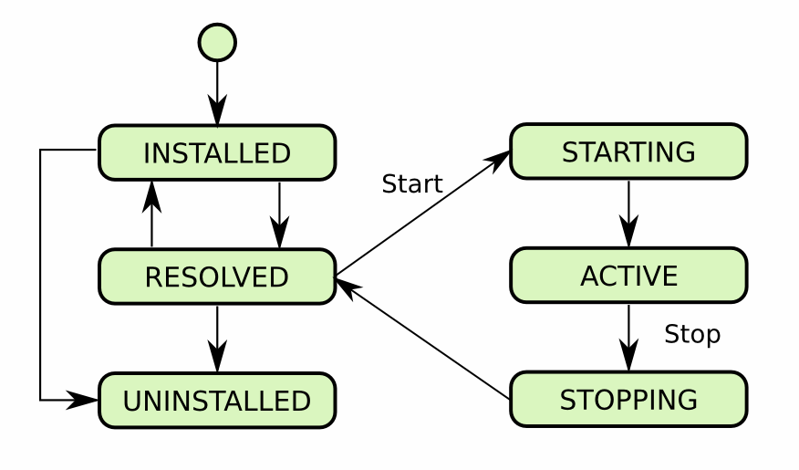

Slide 43
OSGI problems
Steep learning curve
  Mostly due to enforcing modularity
Classloader issues
  Class.forName()
  DynamicImport
Singletons & statics
  single instance per ClassLoader
  do not cross the bundle boundaries
Java Service Loader
  Services defined in META-INF/services
  Can be problematic when each bundle has a separate classloader
  Apache Aries - SPI Fly

Slide 44


Questions?
Martin Ferlan
martinferlan@atron.de
https://github.com/mferlan/osgi.example

